Slide 1
Chapter 1- Software Engineering Process
Chapter 1 Introduction

Slide 2
Topics covered
Professional software development
  What is meant by software engineering.
Software engineering ethics
  A brief introduction to ethical issues that affect software engineering.
Case studies
  An introduction to three examples that are used in later chapters in the book.
30/10/2014
Chapter 1 Introduction

Slide 3
Software engineering
The economies of ALL developed nations are
dependent on software.
More and more systems are software controlled
Software engineering is concerned with theories, methods and tools for professional software development.
Expenditure on software represents a
significant fraction of GNP in all developed countries.
30/10/2014
Chapter 1 Introduction

Slide 4
Software costs
Software costs often dominate computer system costs. The costs of software on a PC are often greater than the hardware cost.
Software costs more to maintain than it does to develop. For systems with a long life, maintenance costs may be several times development costs.
Software engineering is concerned with cost-effective software development.
30/10/2014
Chapter 1 Introduction

Slide 5
Software project failure
Increasing system complexity
  As new software engineering techniques help us to build larger, more complex systems, the demands change. Systems have to be built and delivered more quickly; larger, even more complex systems are required; systems have to have new capabilities that were previously thought to be impossible.
Failure to use software engineering methods
  It is fairly easy to write computer programs without using software engineering methods and techniques. Many companies have drifted into software development as their products and services have evolved. They do not use software engineering methods in their everyday work. Consequently, their software is often more expensive and less reliable than it should be.
30/10/2014
Chapter 1 Introduction

Slide 6




Software project failure
Amazon 1p price glitch | 600,000 RBS payments go missing
Nissan’s airbag glitch | Glitch releases US prisoners early
30/10/2014
Chapter 1 Introduction

Slide 7
Professional software development
30/10/2014
Chapter 1 Introduction

Slide 8
Frequently asked questions about software engineering
Question | Answer
What is software? | Computer programs and associated documentation. Software products may be developed for a particular customer or may be developed for a general market.
What are the attributes of good software? | Good software should deliver the required functionality and performance to the user and should be maintainable, dependable and usable.
What is software engineering? | Software engineering is an engineering discipline that is concerned with all aspects of software production.
What are the fundamental software engineering activities? | Software specification, software development, software validation and software evolution.
What is the difference between software engineering and computer science? | Computer science focuses on theory and fundamentals; software engineering is concerned with the practicalities of developing and delivering useful software.
What is the difference between software engineering and system engineering? | System engineering is concerned with all aspects of computer-based systems development including hardware, software and process engineering. Software engineering is part of this more general process.
30/10/2014
Chapter 1 Introduction

Slide 9
Frequently asked questions about software engineering
Question | Answer
What are the key challenges facing software engineering? | Coping with increasing diversity, demands for reduced delivery times and developing trustworthy software.
What are the costs of software engineering? | Roughly 60% of software costs are development costs, 40% are testing costs. For custom software, evolution costs often exceed development costs.
What are the best software engineering techniques and methods? | While all software projects have to be professionally managed and developed, different techniques are appropriate for different types of system. For example, games should always be developed using a series of prototypes whereas safety critical control systems require a complete and analyzable specification to be developed. You can’t, therefore, say that one method is better than another.
What differences has the web made to software engineering? | The web has led to the availability of software services and the possibility of developing highly distributed service-based systems. Web-based systems development has led to important advances in programming languages and software reuse.
30/10/2014
Chapter 1 Introduction

Slide 10
Software products
Generic products
  Stand-alone systems that are marketed and sold to any customer who wishes to buy them.
  Examples – PC software such as graphics programs, project management tools; CAD software; software for specific markets such as appointments systems for dentists.
Customized products
  Software that is commissioned by a specific customer to meet their own needs.
  Examples – embedded control systems, air traffic control software, traffic monitoring systems.
30/10/2014
Chapter 1 Introduction

Slide 11
Product specification
Generic products
  The specification of what the software should do is owned by the software developer and decisions on software change are made by the developer.
Customized products
  The specification of what the software should do is owned by the customer for the software and they make decisions on software changes that are required.
30/10/2014
Chapter 1 Introduction

Slide 12
Essential attributes of good software
Product characteristic | Description
Maintainability | Software should be written in such a way so that it can evolve to meet the changing needs of customers. This is a critical attribute because software change is an inevitable requirement of a changing business environment.
Dependability and security | Software dependability includes a range of characteristics including reliability, security and safety. Dependable software should not cause physical or economic damage in the event of system failure. Malicious users should not be able to access or damage the system.
Efficiency | Software should not make wasteful use of system resources such as memory and processor cycles. Efficiency therefore includes responsiveness, processing time, memory utilisation, etc.
Acceptability | Software must be acceptable to the type of users for which it is designed. This means that it must be understandable, usable and compatible with other systems that they use.
30/10/2014
Chapter 1 Introduction

Slide 13
Software engineering
Software engineering is an engineering discipline that is concerned with all aspects of software production from the early stages of system specification through to maintaining the system after it has gone into use.
Engineering discipline
  Using appropriate theories and methods to solve problems bearing in mind organizational and financial constraints.
All aspects of software production
  Not just technical process of development. Also project management and the development of tools, methods etc. to support software production.
30/10/2014
Chapter 1 Introduction

Slide 14
Importance of software engineering
More and more, individuals and society rely on advanced software systems. We need to be able to produce reliable and trustworthy systems economically and quickly.
It is usually cheaper, in the long run, to use software engineering methods and techniques for software systems rather than just write the programs as if it was a personal programming project. For most types of system, the majority of costs are the costs of changing the software after it has gone into use.
30/10/2014
Chapter 1 Introduction

Slide 15
Software process activities
Software specification, where customers and engineers define the software that is to be produced and the constraints on its operation.
Software development, where the software is designed and programmed.
Software validation, where the software is checked to ensure that it is what the customer requires.
Software evolution, where the software is modified to reflect changing customer and market requirements.
30/10/2014
Chapter 1 Introduction

Slide 16
General issues that affect software
Heterogeneity
  Increasingly, systems are required to operate as distributed systems across networks that include different types of computer and mobile devices.
Business and social change
  Business and society are changing incredibly quickly as emerging economies develop and new technologies become available. They need to be able to change their existing software and to rapidly develop new software.
30/10/2014
Chapter 1 Introduction

Slide 17
General issues that affect software
Security and trust
  As software is intertwined with all aspects of our lives, it is essential that we can trust that software.
Scale
  Software has to be developed across a very wide range of scales, from very small embedded systems in portable or wearable devices through to Internet-scale, cloud-based systems that serve a global community.
30/10/2014
Chapter 1 Introduction

Slide 18
Software engineering diversity
There are many different types of software system and there is no universal set of software techniques that is applicable to all of these.
The software engineering methods and tools used depend on the type of application being developed, the requirements of the customer and the background of the development team.
30/10/2014
Chapter 1 Introduction

Slide 19
Application types
Stand-alone applications
  These are application systems that run on a local computer, such as a PC. They include all necessary functionality and do not need to be connected to a network.
Interactive transaction-based applications
  Applications that execute on a remote computer and are accessed by users from their own PCs or terminals. These include web applications such as e-commerce applications.
Embedded control systems
  These are software control systems that control and manage hardware devices. Numerically, there are probably more embedded systems than any other type of system.
30/10/2014
Chapter 1 Introduction

Slide 20
Application types
Batch processing systems
  These are business systems that are designed to process data in large batches. They process large numbers of individual inputs to create corresponding outputs.
Entertainment systems
  These are systems that are primarily for personal use and which are intended to entertain the user.
Systems for modeling and simulation
  These are systems that are developed by scientists and engineers to model physical processes or situations, which include many, separate, interacting objects.
30/10/2014
Chapter 1 Introduction

Slide 21
Application types
Data collection systems
  These are systems that collect data from their environment using a set of sensors and send that data to other systems for processing.
Systems of systems
  These are systems that are composed of a number of other software systems.
30/10/2014
Chapter 1 Introduction

Slide 22
Software engineering fundamentals
Some fundamental principles apply to all types of software system, irrespective of the development techniques used:
  Systems should be developed using a managed and understood development process. Of course, different processes are used for different types of software.
  Dependability and performance are important for all types of system.
  Understanding and managing the software specification and requirements (what the software should do) are important.
  Where appropriate, you should reuse software that has already been developed rather than write new software.
30/10/2014
Chapter 1 Introduction

Slide 23
Software engineering ethics
30/10/2014
Chapter 1 Introduction

Slide 24
Software engineering ethics
Software engineering involves wider responsibilities than simply the application of technical skills.
Software engineers must behave in an honest and ethically responsible way if they are to be respected as professionals.
Ethical behaviour is more than simply upholding the law but involves following a set of principles that are morally correct.
30/10/2014
Chapter 1 Introduction

Slide 25
Issues of professional responsibility
Confidentiality
  Engineers should normally respect the confidentiality of their employers or clients irrespective of whether or not a formal confidentiality agreement has been signed.
Competence
  Engineers should not misrepresent their level of competence. They should not knowingly accept work which is out with their competence.
30/10/2014
Chapter 1 Introduction

Slide 26
Issues of professional responsibility
Intellectual property rights
  Engineers should be aware of local laws governing the use of intellectual property such as patents, copyright, etc. They should be careful to ensure that the intellectual property of employers and clients is protected.
Computer misuse
  Software engineers should not use their technical skills to misuse other people’s computers. Computer misuse ranges from relatively trivial (game playing on an employer’s machine, say) to extremely serious (dissemination of viruses).
30/10/2014
Chapter 1 Introduction

Slide 27
ACM/IEEE Code of Ethics
The professional societies in the US have cooperated to produce a code of ethical practice.
Members of these organisations sign up to the code of practice when they join.
The Code contains eight Principles related to the behaviour of and decisions made by professional software engineers, including practitioners, educators, managers, supervisors and policy makers, as well as trainees and students of the profession.
30/10/2014
Chapter 1 Introduction

Slide 28
Rationale for the code of ethics
  Computers have a central and growing role in commerce, industry, government, medicine, education, entertainment and society at large. Software engineers are those who contribute by direct participation or by teaching, to the analysis, specification, design, development, certification, maintenance and testing of software systems.
  Because of their roles in developing software systems, software engineers have significant opportunities to do good or cause harm, to enable others to do good or cause harm, or to influence others to do good or cause harm. To ensure, as much as possible, that their efforts will be used for good, software engineers must commit themselves to making software engineering a beneficial and respected profession.
30/10/2014
Chapter 1 Introduction

Slide 29
The ACM/IEEE Code of Ethics
Software Engineering Code of Ethics and Professional Practice
ACM/IEEE-CS Joint Task Force on Software Engineering Ethics and Professional Practices
PREAMBLE
The short version of the code summarizes aspirations at a high level of the abstraction; the clauses that are included in the full version give examples and details of how these aspirations change the way we act as software engineering professionals. Without the aspirations, the details can become legalistic and tedious; without the details, the aspirations can become high sounding but empty; together, the aspirations and the details form a cohesive code.
Software engineers shall commit themselves to making the analysis, specification, design, development, testing and maintenance of software a beneficial and respected profession. In accordance with their commitment to the health, safety and welfare of the public, software engineers shall adhere to the following Eight Principles:
30/10/2014
Chapter 1 Introduction

Slide 30
Ethical principles
1. PUBLIC - Software engineers shall act consistently with the public interest.
2. CLIENT AND EMPLOYER - Software engineers shall act in a manner that is in the best interests of their client and employer consistent with the public interest.
3. PRODUCT - Software engineers shall ensure that their products and related modifications meet the highest professional standards possible.
4. JUDGMENT - Software engineers shall maintain integrity and independence in their professional judgment.
5. MANAGEMENT - Software engineering managers and leaders shall subscribe to and promote an ethical approach to the management of software development and maintenance.
6. PROFESSION - Software engineers shall advance the integrity and reputation of the profession consistent with the public interest.
7. COLLEAGUES - Software engineers shall be fair to and supportive of their colleagues.
8. SELF - Software engineers shall participate in lifelong learning regarding the practice of their profession and shall promote an ethical approach to the practice of the profession.
30/10/2014
Chapter 1 Introduction

Slide 31
Case studies
30/10/2014
Chapter 1 Introduction

Slide 32
Ethical dilemmas
Disagreement in principle with the policies of senior management.
Your employer acts in an unethical way and releases a safety-critical system without finishing the testing of the system.
Participation in the development of military weapons systems or nuclear systems.
30/10/2014
Chapter 1 Introduction

Slide 33
Case studies
A personal insulin pump
  An embedded system in an insulin pump used by diabetics to maintain blood glucose control.
A mental health case patient management system
  Mentcare. A system used to maintain records of people receiving care for mental health problems.
A wilderness weather station
  A data collection system that collects data about weather conditions in remote areas.
iLearn: a digital learning environment
  A system to support learning in schools
30/10/2014
Chapter 1 Introduction

Slide 34
Insulin pump control system
Collects data from a blood sugar sensor and calculates the amount of insulin required to be injected.
Calculation based on the rate of change of blood sugar levels.
Sends signals to a micro-pump to deliver the correct dose of insulin.
Safety-critical system as low blood sugars can lead to brain malfunctioning, coma and death; high-blood sugar levels have long-term consequences such as eye and kidney damage.
30/10/2014
Chapter 1 Introduction

Slide 35
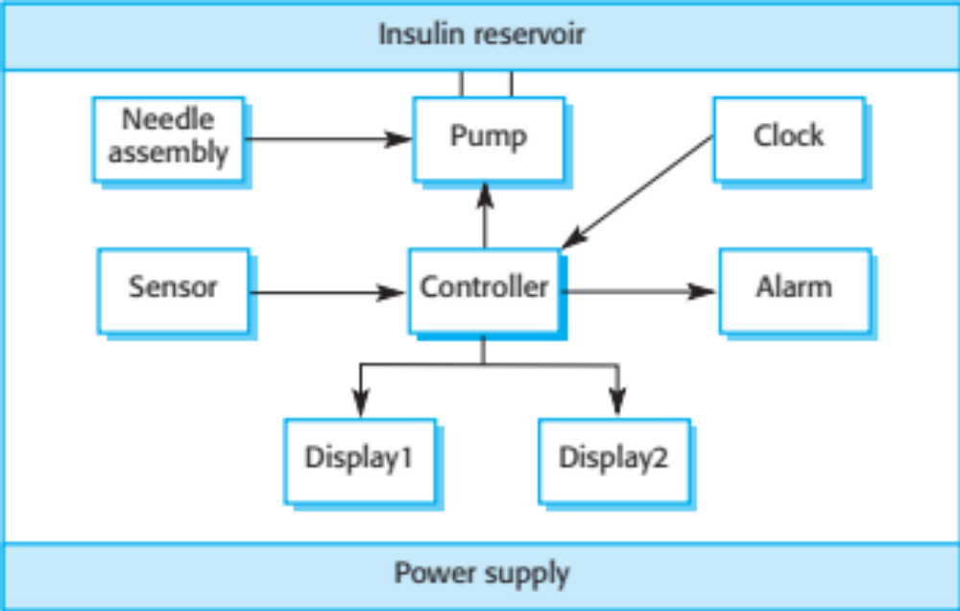
Insulin pump hardware architecture
30/10/2014
Chapter 1 Introduction

Slide 36
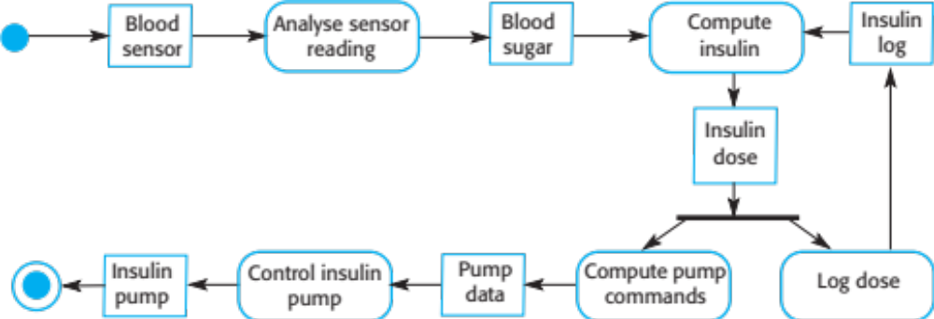
Activity model of the insulin pump
30/10/2014
Chapter 1 Introduction

Slide 37
Essential high-level requirements
The system shall be available to deliver insulin when required.
The system shall perform reliably and deliver the correct amount of insulin to counteract the current level of blood sugar.
The system must therefore be designed and implemented to ensure that the system always meets these requirements.
30/10/2014
Chapter 1 Introduction

Slide 38
Mentcare: A patient information system for mental health care
A patient information system to support mental health care is a medical information system that maintains information about patients suffering from mental health problems and the treatments that they have received.
Most mental health patients do not require dedicated hospital treatment but need to attend specialist clinics regularly where they can meet a doctor who has detailed knowledge of their problems.
To make it easier for patients to attend, these clinics are not just run in hospitals. They may also be held in local medical practices or community centres.
30/10/2014
Chapter 1 Introduction

Slide 39
Mentcare
Mentcare is an information system that is intended for use in clinics.
It makes use of a centralized database of patient information but has also been designed to run on a PC, so that it may be accessed and used from sites that do not have secure network connectivity.
When the local systems have secure network access, they use patient information in the database but they can download and use local copies of patient records when they are disconnected.
30/10/2014
Chapter 1 Introduction

Slide 40
Mentcare goals
To generate management information that allows health service managers to assess performance against local and government targets.
To provide medical staff with timely information to support the treatment of patients.
30/10/2014
Chapter 1 Introduction

Slide 41
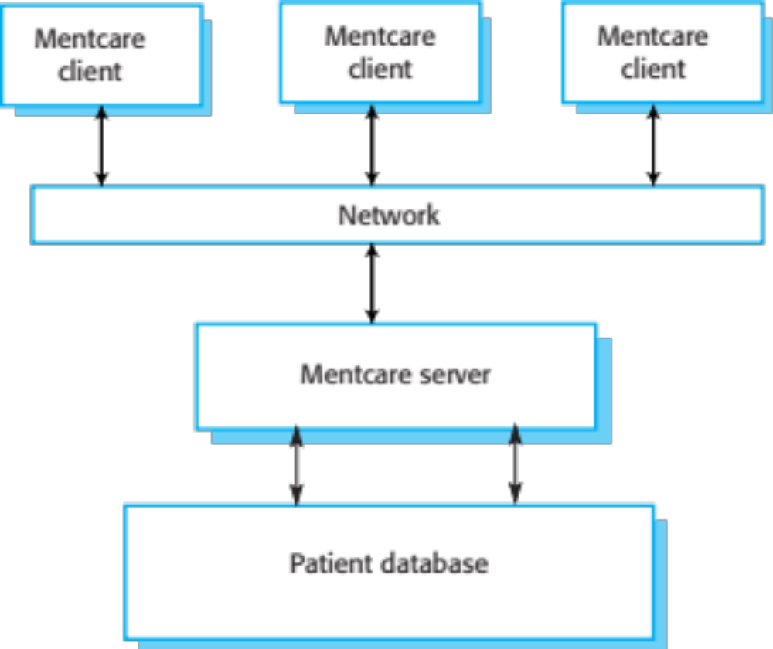
The organization of the Mentcare system
30/10/2014
Chapter 1 Introduction

Slide 42
Key features of the Mentcare system
Individual care management
  Clinicians can create records for patients, edit the information in the system, view patient history, etc. The system supports data summaries so that doctors can quickly learn about the key problems and treatments that have been prescribed.
Patient monitoring
  The system monitors the records of patients that are involved in treatment and issues warnings if possible problems are detected.
Administrative reporting
  The system generates monthly management reports showing the number of patients treated at each clinic, the number of patients who have entered and left the care system, number of patients sectioned, the drugs prescribed and their costs, etc.
30/10/2014
Chapter 1 Introduction

Slide 43
Mentcare system concerns
Privacy
  It is essential that patient information is confidential and is never disclosed to anyone apart from authorised medical staff and the patient themselves.
Safety
  Some mental illnesses cause patients to become suicidal or a danger to other people. Wherever possible, the system should warn medical staff about potentially suicidal or dangerous patients.
  The system must be available when needed otherwise safety may be compromised and it may be impossible to prescribe the correct medication to patients.
30/10/2014
Chapter 1 Introduction

Slide 44
iLearn: A digital learning environment
A digital learning environment is a framework in which a set of general-purpose and specially designed tools for learning may be embedded plus a set of applications that are geared to the needs of the learners using the system.
The tools included in each version of the environment are chosen by teachers and learners to suit their specific needs.
  These can be general applications such as spreadsheets, learning management applications such as a Virtual Learning Environment (VLE) to manage homework submission and assessment, games and simulations.
30/10/2014
Chapter 1 Introduction

Slide 45
Service-oriented systems
The system is a service-oriented system with all system components considered to be a replaceable service.
This allows the system to be updated incrementally as new services become available.
It also makes it possible to rapidly configure the system to create versions of the environment for different groups such as very young children who cannot read, senior students, etc.
30/10/2014
Chapter 1 Introduction

Slide 46
iLearn services
Utility services that provide basic application-independent functionality and which may be used by other services in the system.
Application services that provide specific applications such as email, conferencing, photo sharing etc. and access to specific educational content such as scientific films or historical resources.
Configuration services that are used to adapt the environment with a specific set of application services and do define how services are shared between students, teachers and their parents.
30/10/2014
Chapter 1 Introduction

Slide 47
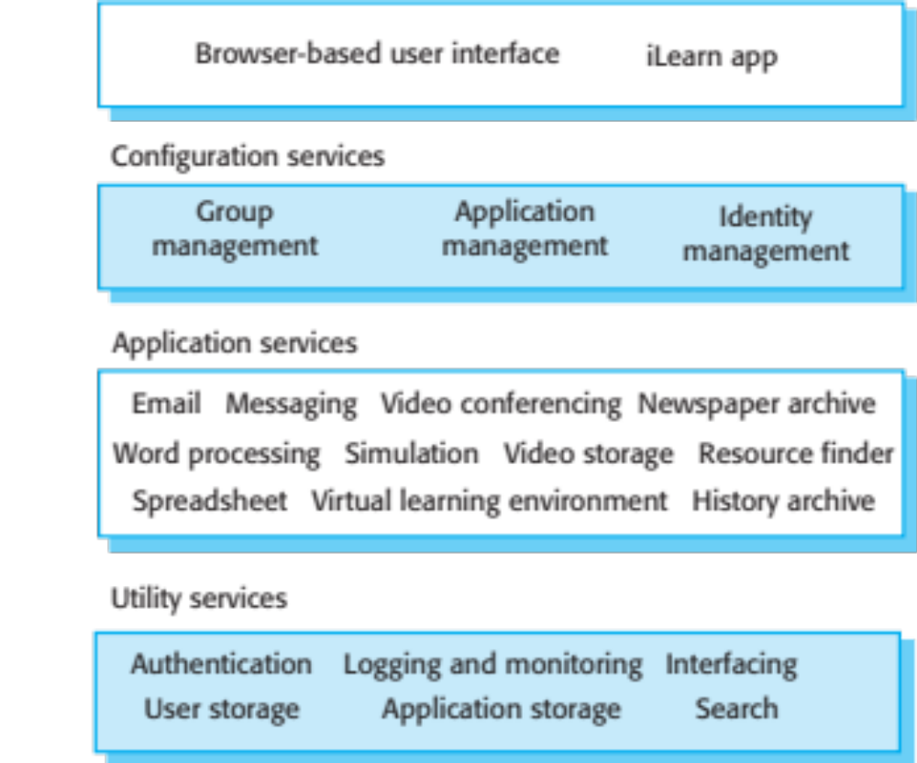
iLearn architecture
30/10/2014
Chapter 1 Introduction

Slide 48
iLearn service integration
Integrated services are services which offer an API (application programming interface) and which can be accessed by other services through that API. Direct service-to-service communication is therefore possible.
Independent services are services which are simply accessed through a browser interface and which operate independently of other services. Information can only be shared with other services through explicit user actions such as copy and paste; re-authentication may be required for each independent service.
30/10/2014
Chapter 1 Introduction

Slide 49
Key points
Software engineering is an engineering discipline that is concerned with all aspects of software production.
Essential software product attributes are maintainability, dependability and security, efficiency and acceptability.
The high-level activities of specification, development, validation and evolution are part of all software processes.
The fundamental notions of software engineering are universally applicable to all types of system development.
30/10/2014
Chapter 1 Introduction

Slide 50
Key points
There are many different types of system and each requires appropriate software engineering tools and techniques for their development.
The fundamental ideas of software engineering are applicable to all types of software system.
Software engineers have responsibilities to the engineering profession and society. They should not simply be concerned with technical issues.
Professional societies publish codes of conduct which set out the standards of behaviour expected of their members.
30/10/2014
Chapter 1 Introduction

